Slide 1
How to create a prompt in an Alma Analytics report
Yoel Kortick – Senior Librarian

Slide 2
  Introduction
  Creating the prompt
  Running the report

Slide 3


Introduction

Slide 4
Introduction
Prompts may be used in Alma analytics reports to allow the user (person running the report) to enter retrieval parameters according to a specific need.
For example instead of a report being hardcoded to retrieve all loans made for items in “Main Library Open Stacks location” for “June 01 to June 30 2021” prompts may be used.
One prompt would be “Item location” and the other prompt would be “Loan Date” with operator “is between” (for a span of dates)
The user running the report could then enter whatever location and dates he wants

Slide 5
Introduction
In our example here we will use a report called “Loans in Main Library by date and location”
This report will produce a table with the amount of loans for items in the main library by date and location.
The parameters of the time span of the receiving date and the location(s) will both be filled in by the user via prompts.

Slide 6
Introduction
Note that there are multiple ways to create prompts for reports. In our case we will create the prompt from within the report and not call it from outside of the report.
There are three kinds of prompts which may be added to an Alma Analytics report:
  Column prompt
  Variable prompt
  Image prompt
In this presentation we will use the Column Prompt.

Slide 7

Creating the prompt

Slide 8
Creating the prompt
Before the prompts are made first create the report.
Do not include filters in the report for the values for which you will prompt.
In our case we will not create filters for the date of the loan or location of the item. We will have a filter for the library name.
The filters for location and date will be done after the user fills in the prompt.

Slide 9
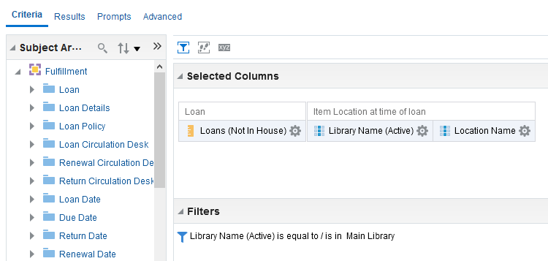
Creating the prompt
Here is the report criteria

Slide 10
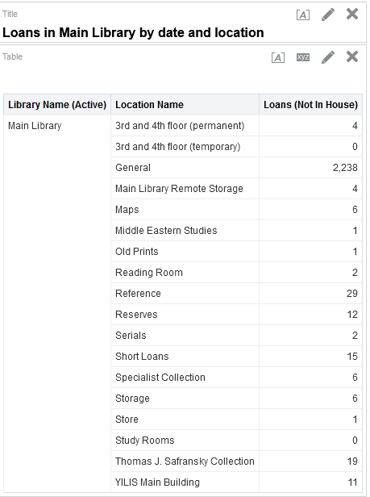
Creating the prompt
Here are the report results

Slide 11
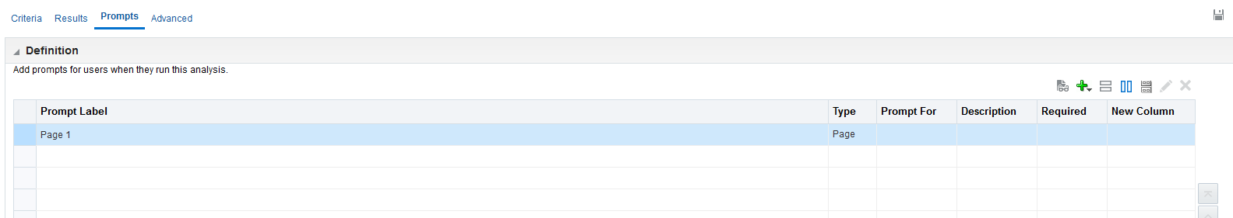
Creating the prompt
From the “Prompts” tab click the plus sign to add a new prompt

Slide 12
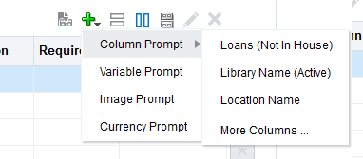
Creating the prompt
Choose “Column Prompt” and then the field on which you want the prompt to work.
Fields which already appear in the report will be available to choose for the new prompt.
If you want a prompt for a field not yet in the report then choose “More Columns”
The first prompt will be for location name

Slide 13
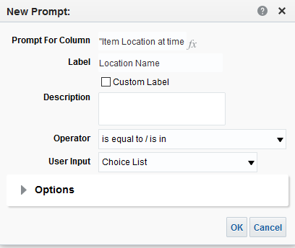
Creating the prompt
We will choose to create this prompt with Operator “is equal to / is in” and User Input “Choice List”

Slide 14
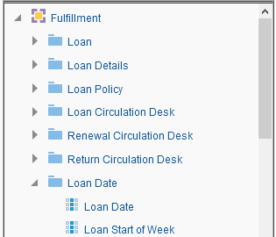
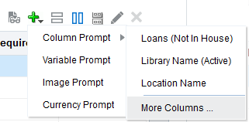
Creating the prompt
Now we want to create the prompt for loan date.
This field has not been used in the report and thus we must choose “More Columns” and then the Loan Date.

Slide 15
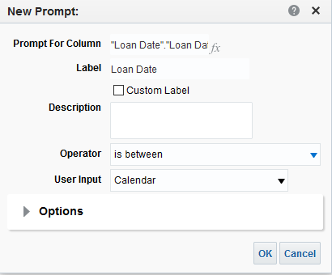
Creating the prompt
We will choose to create this prompt with Operator “is between” and User Input “Calendar”

Slide 16

Running the report

Slide 17

Running the report
Let’s now run the report to test it.
The prompt will appear if we do “open” on the report but not if we do “edit”.

Slide 18
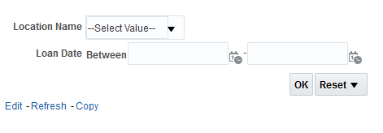
Running the report
The user is presented with prompts
Click here to run it after filling in prompts

Slide 19
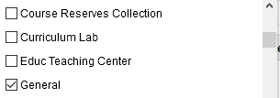

Running the report
First we choose the General location and then scroll down more and choose the YILIS Main Building location

Slide 20
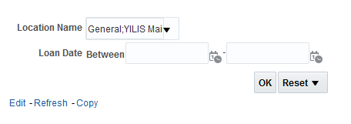
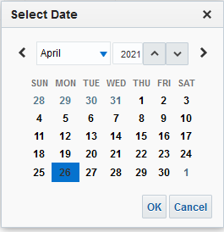
Running the report
Now we choose the dates span using the calendar
The locations are already filled in now
Click the calendar icon to choose the dates

Slide 21
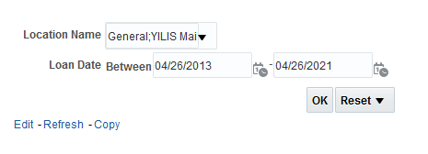
Running the report
All is filled in and we can run the report
Click here to run it after filling in prompts

Slide 22
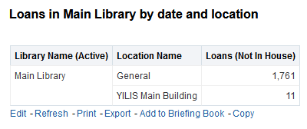
Running the report
And we successfully get our results for the two locations chosen and for the time span chosen

Slide 23
xxx@exlibrisgroup.com

